Slide 1

Utilizing Respondents’ Previously Reported Data in a Census of Establishments: Results from an Experiment in the Census of Agriculture’s 2020 Content Test
FCSM Research & Policy Conference
November 4, 2021
Joseph Rodhouse
Kathy Ott
The Findings and Conclusions in This Preliminary Publication Have Not Been Formally Disseminated by the U.S. Department of Agriculture and Should Not Be Construed to Represent Any Agency Determination or Policy.

Slide 2
Introduction
The Census of Agriculture (COA) is conducted every five years.
The only source of uniform, comprehensive and impartial agricultural data for every county in the U.S.
The response rates to the COA have historically been high, usually at or above 80 percent.
However, the COA’s response rates have declined since 2002, with the lowest in recent decades occurring in the latest iteration in 2017 (Reist et al. 2019).

Slide 3
Introduction (cont.)
Over the years, respondent burden has been a common theme uncovered by qualitative studies conducted with farmers and ranchers at NASS.
These concerns were thoroughly detailed in the report “In their own words: results from triangulating qualitative methodologies to understand why farmers do and do not respond to NASS surveys” by Pick et al (2018).
For example, the report found that when asked “How can NASS better serve you, the farmer or rancher?” responses included:
“Make reporting easier for me”
“Make questions and questionnaires easy to answer”
“Use data I’ve previously reported to either NASS or other USDA agencies”

Slide 4
Motivation for PRD Use
As a response to:
Declining participation in the COA
Concerns from farmers about increased burden overall
NASS is currently exploring the possibility of:
Feeding forward respondents’ previously reported data (PRD) in the web instrument of the 2022 Census of Agriculture (COA) to aid respondents in the completion of their forms.
Two goals of this research:
Examine whether using PRD can increase response rates
Examine whether PRD can decrease respondent burden in the COA.

Slide 5
Background: PRD in Official Statistics
Currently, NASS has the capability to “pre-print” respondents’ PRD in the web mode of surveys.
i.e., prefilling answers with respondents’ most recent responses to the same questions.
Holmberg (2004) summarizes the pros and cons of “pre-printing” respondents’ PRD in self-administered surveys (e.g., paper or web) from the perspective of official statistics.
Pros:
Reduce respondent burden of answering frequently asked/repeated questions.
Questionnaire guidance, memory support, and anchoring.
Respondents appreciate when their historical data is given back to them.
Reduction of measurement errors and improved data quality.
Notes:
As you saw in my colleague Heather Ridolfo’s presentation, currently nass has the capability to pre-print respondents’ prd in the web mode of survey. As Heather showed in screen shots of the web instrument, that meant prefilling answers with respondents’ most recent responses to the same questions. Holmberg, writing on behalf of statistics Sweden, summarized the pros and cons of pre-printing respondens’ prd in self-administered surveys from the perspective of official statistics. Pre-printing PRD can reduce respondent burden: in other words, frequently asking the respondent to fill in the same (hardly ever changing) statistics can seem unnecessary from a respondent
perspective. Since respondents simply can verify that the pre-printed values still
are valid or update them if necessary, pre-printing available data avoids this. With regard to questionnaire guidance, memory support and anchoring, pre-printing can help
the respondent to recognise what information is requested, where to put it in the questionnaire, and whether the intended response is reasonable given the pre-printed information. Pre-printing can also help to keep track of events in time (e.g., whether an event has already been reported or not). Respondents also appreciate when their historical data is given back to them and it can result in a reduction of measurement errors and improve data quality, since pre-printing makes it possible for the respondent to check, react to, and correct previously collected information, yielding fewer spurious reports of changes and inconsistencies in data over time.

Slide 6
PRD In Official Statistics (cont.)
Holmberg (2004)
Cons:
Risk of bias/underreporting of changes and conservation of errors.
Satisficing (Krosnick 1991).
Loss of confidence and goodwill.
Disclosure risk.
Economic implications:
Costs to operationalize
Industries that rely on official statistical reports
Of note, recent research on pre-printing PRD in the web mode of a quarterly NASS survey, Young et al (in press) found:
no negative impacts to data quality compared to a control group
no evidence of systematic or increased satisficing
Notes:
Holmberg also discusses some cons of preprinting prd, which I will briefly summarize. The first is that there is a risk of bias due to underreporting of changes, and a risk of the conservation of previous errors in the current survey. Pre-printing may also increase the risk of satisficing, if respondents simply accept their prd without full consideration for if the previous answer is still valid. When the PRD is wrong, or the respondent doesn’t remember providing it, it can result in strong negative reactions, and respondents may lose confidence and goodwill toward the organization conducting the survey. Heather Ridolfo provided some good examples of the types of negative respondent reactions that can happen when they viewed the pre-printed prd as being wrong or unrecognizable. There is also the risk that pre-printed data will be disclosed to outsiders. Lastly, economic implications, such as the cost to the organization to operationalize in practice, and the impact to data that industries rely on to make business decisions, may make the inclusion of prd in official statistics unwise. However, it is worth noting that recent research on pre-printing prd in the web mode of a quarterly NASS survey found no negative impacts to data quality compared to a control group, and no evidence of systematic or increased satisficing.

Slide 7
Operationalization of PRD in the COA
With the intention of combating nonresponse and reducing respondent burden in the COA, the Non-Edited Respondent Data (NERD) team was formed at NASS in August 2019.
A major goal of the team was to test the impact of utilizing respondents’ previously reported data in a test of the upcoming 2022 COA.
Known at NASS as the COA Content Test, this important survey allows NASS to evaluate the efficacy of the existing COA questionnaire and data collection protocols.
Provides an opportunity to test existing practices against experimental questions and procedures.
Occurs two years before each iteration of the actual COA with a representative sample of agricultural operations.

Slide 8
Pre-Printing PRD in the 2020 COA Content Test
Pre-Printing Experiment
PRD pre-printed in the web mode of the COA Content Test.
Population of 267,000 with PRD available for use in the Content Test.
Sample size n=9,000 for the experiment.
Sample stratified by region, amount of PRD, and age of PRD.
Sorted by predicted response propensity, farm type, and farm size.
Data collection January 2021 – May 2021.
January-March paper/mail and web only response modes.
April-May NRFU follow-up via CATI.
Notes:
So, the NERD team planned and executed a pre-printing of prd experiment in the web mode of the 2020 COA content test. For this experiment, there was a population of about 267,000 with prd available to be pre-printed in the content test form, and we had the ability to select a sample of 9,000 from this population. The selected sample was stratified by agricultural region, the amount of prd they had available to be pre-printed in the content test, and age of the prd, or in other words, how long ago the data was reported. The sample was also sorted by predicted response propensity, farm type, and farm size. Data collection for the COA content test ran from January to May 2021. From January to march, sampled operations could respond via paper & mail or by the web, where there prd was pre-printed. Nonresponse follow-up was then conducted exclusively via CATI from April to May.

Slide 9
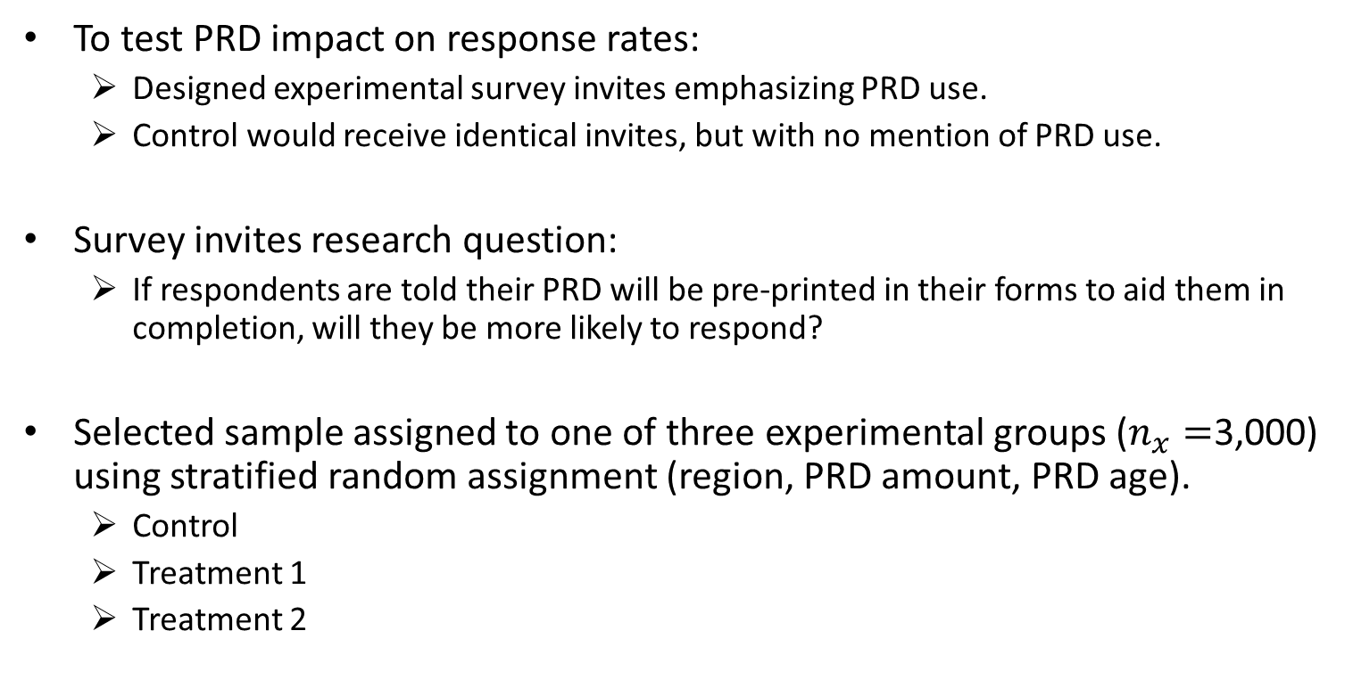
PRD Pre-Printing Experiment in the COA Content Test
To test PRD impact on response rates:
Designed experimental survey invites emphasizing PRD use.
Control would receive identical invites, but with no mention of PRD use.
Survey invites research question:
If respondents are told their PRD will be pre-printed in their forms to aid them in completion, will they be more likely to respond?
Selected sample assigned to one of three experimental groups ($n_{x}=$3,000) using stratified random assignment (region, PRD amount, PRD age).
Control
Treatment 1
Treatment 2
Notes:
As I mentioned earlier, one of the reasons to conduct the pre-printing experiment was as a result of declining response rates in the COA. So, to test if prd has an impact on response rates, we design experimental survey invites emphasizing PRD’s use in the web forms. The response rates to these experimental invites would then be compared to the response rates of a control group that received identical invites, with the only exception being no mention of prd use. The thought being, if respondents are told their PRD will be pre-printed in their forms to aid them in form completion, will the by more likely to respond? Based on our available sample size, we decided to assign the selected sample to one of three experimental groups to test this question, using stratified random assignment, resulting in a control and two treatment groups.

Slide 10
PRD Pre-Printing Experiment in the COA Content Test
Two Main Experimental Conditions
Factor A: PRD use in the web mode, or not.
Factor B: Mailed invites emphasizing PRD use, or not.
Group Conditions
Control: PRD in web mode not used, mailed invites do not emphasize PRD
Treatment 1: PRD used in web mode, mailed invites do not emphasize PRD
Treatment 2: PRD used in web mode, mailed invites emphasize PRD use
This design allows us to disentangle whether impact to response is influenced by mere presence of PRD or invites emphasizing its use.

Slide 11
Experimental Invites Mailouts
Data collection for the experiment ran from January to May 2021.
In total, five invite mailings sent to each experimental group:
January 4, 2021 (Web Push mailing)
January 18, 2021 (Initial paper mailout, includes q’aire & instruction booklet)
February 8, 2021 (Follow-up mailout)
February 22, 2021 (Follow-up mailout, includes q’aire & instruction booklet)
March 12, 2021 (Final mailout, includes q’aire & instruction booklet)
CATI nonresponse follow-up began April 1.
Notes:
As I mentioned earlier, data collection for the coa content test ran from January to may 2021. However, the mailed survey invites occurred from January to March. In total, there were five invite mailing sent to each experimental group. Each groups mailed invites were sent on the following dates. CATI nonresponse follow-ups began on April 1. It may be worth noting that no prd was used in CATI and the CATI interviewers did not mention to respondents that prd would be used.

Slide 12
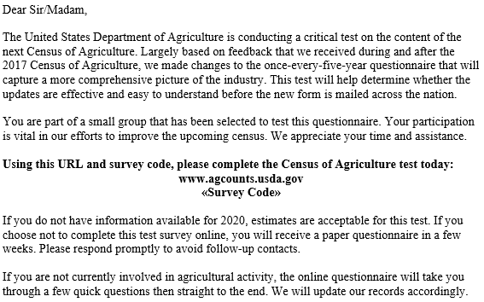
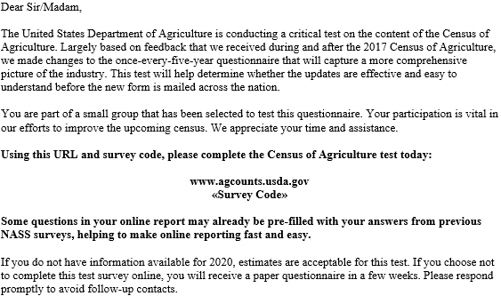
Experimental Contact Example: First Mailout
Control & Treatment 1: Mailing #1
Treatment 2: Mailing #1
Notes:
On this slide you can see the screen shots of the first survey invites that were mailed to our experimental groups. The screen shot on the left show the invite that the control group and treatment 1 group received, and the screen shot on the right shows the invite that the treatment 2 group received. The text of the invites are identical, except you’ll notice inside the orange box on the right the text emphasizing the use of PRD in treatment 2’s web form. It reads “Some questions in your online report may already be pre-filled with your answers from previous NASS surveys, helping to make online reporting fast and easy.”

Slide 13
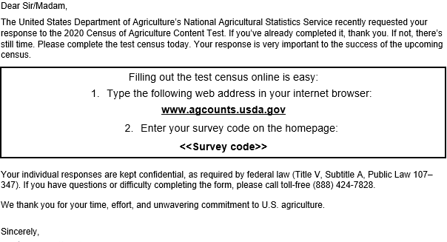
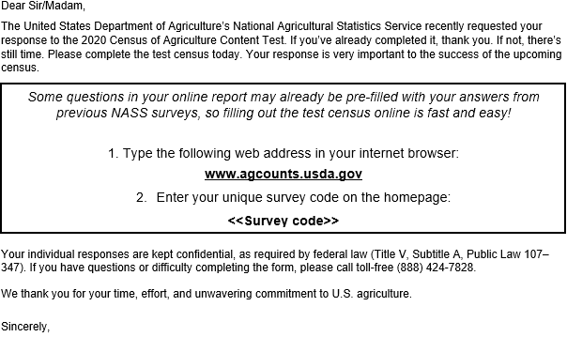
Experimental Contact Example: Follow-up Mailout
Control & Treatment 1: Mailing #3
Treatment 2: Mailing #3
Notes:
On this slide you’ll see an example of one of the follow-up mailings that were sent to respondents who had not responded by the time of the third mailing on February 8th. Again, you’ll notice that the text in the invites is identical except for that in the orange box in the screen shot on the right that was sent to treatment group 2.

Slide 14
Respondent Perception of Burden: PRD Debriefing Questions
At the very end of the web instrument, respondents in the two PRD groups were asked to provide their opinions on the use of PRD in the survey.
The lead-in read: Before submitting your data, please provide your opinions about pre-filled information used in some answer cells in this survey. If you do not wish to provide your opinions, please scroll to the bottom and press “next”.
This section contained seven questions on a 5-point agree/disagree scale, with an eighth (and final) question asking respondents for open-ended remarks about pre-printed PRD.
The seven questions then asked of respondents about pre-printed PRD were as follows:
It was clear to me that NASS pre-filled information in some answer cells in advance
I recall providing the pre-filled information used in the answer cells on a previous NASS survey
The pre-filled information in the answer cells was accurate
The pre-filled information made it easier for me to complete the survey
The pre-filled information helped me finish the survey faster
I would have liked to see pre-filled information in more answer cells
Overall, I have a positive reaction to pre-filled information being used in the survey
Please provide any feedback about the pre-filled information [open-ended text box]

Slide 15
Research Goals
Two goals of this research:
Examine whether using PRD in the web mode and emphasizing its use in the survey invites can increase the response rate.
Judging by experimental group response rates.
Examine whether PRD can decrease respondent burden in the COA.
Using evidence from the PRD debriefing questions.

Slide 16
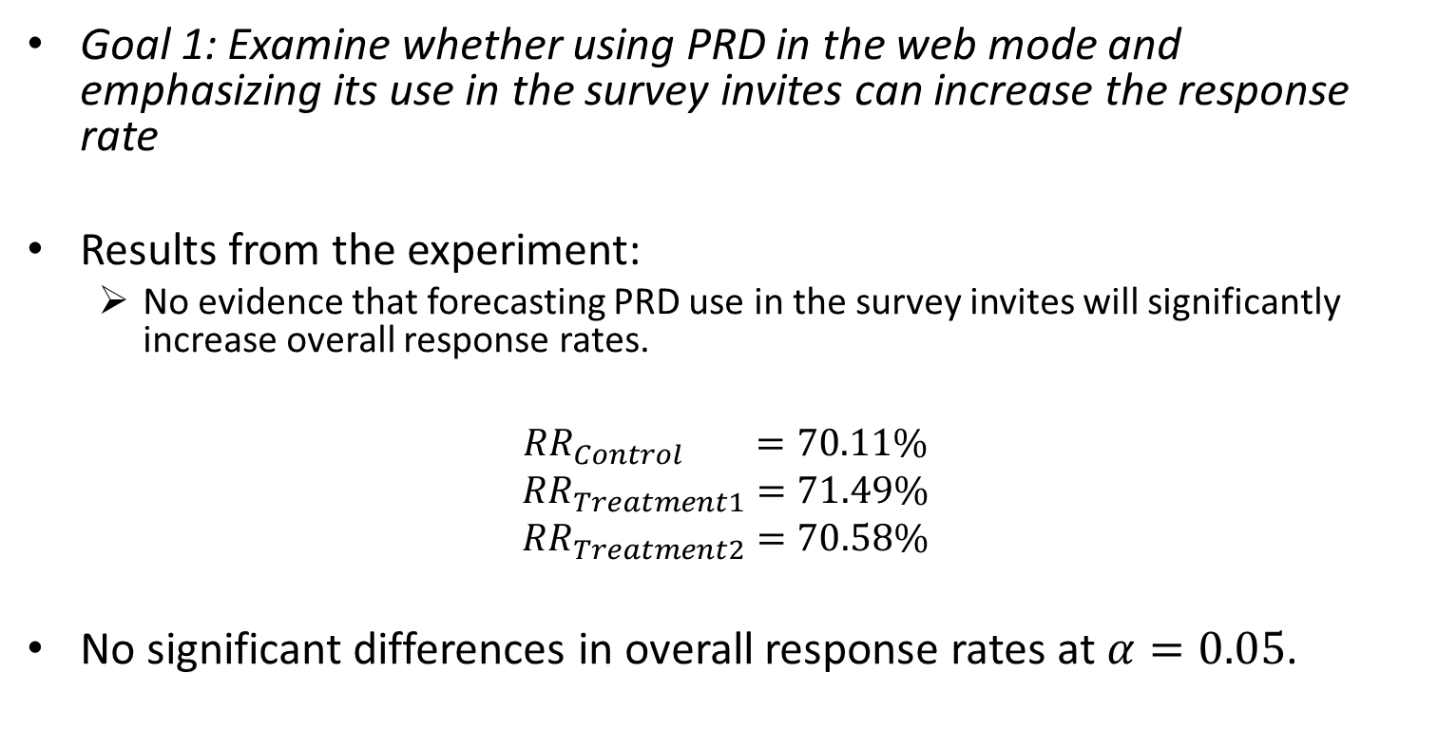
Results: Goal 1
Goal 1: Examine whether using PRD in the web mode and emphasizing its use in the survey invites can increase the response rate
Results from the experiment:
No evidence that forecasting PRD use in the survey invites will significantly increase overall response rates.
$${RR}_{Control} =70.11\%$$
$${RR}_{Treatment1}=71.49\%$$
$${RR}_{Treatment2}=70.58\%$$
No significant differences in overall response rates at $α=0.05$.

Slide 17
Results: Goal 1 (cont.)
However, experimental invites emphasizing PRD did result in a significant increase in the proportion of web respondents.
Percentage of respondents responding via the web:
Control = 78.24%
Treatment 1 = 77.72%
Treatment 2 = 82.28%
Chi-square = 25.62, p < .0001 suggests there is an association between experiment group and web response.
Invites emphasizing PRD use resulted in 16% higher odds of being web respondent than the Control.
Logistic Regression Wald Chi-square = 98.23, p < .0001.

Slide 18
Results: Goal 2
Goal 2: Examine whether PRD can decrease respondent burden in the COA.
Results from the PRD debriefing questions:
Evidence supports that preprinting PRD in the web mode can decrease respondent burden (or at least their perception of burden) more often than not.
Debriefing Question:
“The pre-filled information made it easier for me to complete the survey.”
72% Agree/Strongly Agree vs. 8% Disagree/Strongly Disagree
“The pre-filled information helped me finish the survey faster.”
70% Agree/Strongly Agree vs. 10% Disagree/Strongly Disagree
“The pre-filled information in the answer cells was accurate.”
74% Agree/Strongly Agree vs. 8% Disagree/Strongly Disagree

Slide 19
Conclusion
Emphasizing the use of PRD in survey invites does not increase overall response rates but does increase the proportion of web respondents.
Respondents tended to perceive PRD as helping them complete the survey faster and easier, and overall had a positive reaction to its use.
“Overall, I have a positive reaction to pre-filled information being used in the survey.”
72% Agree/Strongly Agree vs. 6% Disagree/Strongly Disagree
Notes:
You’ll recall that this research had two main objectives, to see if we can use prd to increase response rates, and to see if we can use prd to decrease respondent burden. In conclusion, we can say that emphasizing the use of prd in the survey invites does not increase overall response rates, but it does increase the proportion of web respondents. Although it is not the full desired result, increasing web response is an auxiliary benefit because it increase data collection efficiency and reduces the cost per complete in most cases. We can also conclude that pre-printing respondents’ prd in the web form reduced respondents’ perceived burden, as they viewed it helping them complete the survey faster and more easily. 72% of respondents agreed or strongly agreed with the statement ‘overall, I have a positive reaction to pre-filled information being used in the survey.” With only 6% disagreeing or strongly disagreeing with that statement. These results suggest that pre-printing respondents’ prd in the actual COA in 2022 would be welcomed by respondents in the majority of cases.

Slide 20
Limitations & Future Research
Only able to test one version of experimental invites emphasizing PRD
Are there other ways to emphasize PRD in invites that are more compelling, and hence, might result in higher response rates?
Cognitive testing planned to gain qualitative insight into respondent perceptions of PRD invite wording
Sample had high predicted propensity to respond (median propensity = 0.77).
Impact of PRD invites may have been mitigated by already high probability of response in each experimental group.
Would different results be observed among those with significantly lower response propensities?
Future research:
Should examine multiple experimental versions of PRD-emphasized invites to determine whether there is an optimal wording for increasing response rates.
Should examine whether PRD emphasized survey invites result in higher response rates among those with a low probability to respond.
Notes:
To wrap up, I will discuss some limitations to this research, and the potential for future research. The first limitation is that we were only able to test one version of experimental invites emphasizing prd use. We didn’t find a significant increase in response rates, but are there other way to emphasize prd in survey invites that are more compelling than used in this experiment, and hence, might result in higher response rates? To investigate this, the NERD team is planning to conduct cognitive interviews aimed at gaining insight into respondent reactions to prd-invite wording to understand if and where the wording can be made more compelling. Another limitation is that the universe from which the sample was selected for this experiment had a high predicted propensity to respond, with a median respond propensity on the sample frame of 0.77. As a result, the impact of the prd invites may have been mitigated by a sample that already had a high probability of response. Which leaves us to wonder if different results might be observed among those with significantly lower response propensities. Two avenues for future research are recommended here. The first is that multiple experimental versions of prd-emphasized invites should be tested to determine whether there is an optimal wording for increasing response rates. The second is that an experiment should be conducted to determine whether PRD emphasized survey invites result in higher response rates among those with a low probability to respond.

Slide 21
Thank You
Joseph.Rodhouse@usda.gov

